Slide 1
Autonomous Vocal and Backing Track Mixing
Kelian (Mike) Li
Music Informatics Group

Slide 2
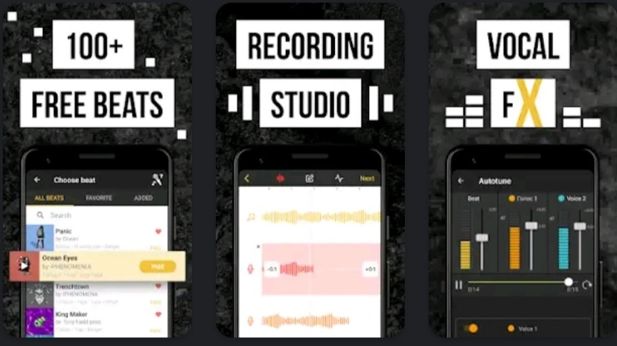
Motivation
Karaoke apps
Amateur music makers

Slide 3
Baseline System: level and compression
Use the average values extracted from the source-separated Million Song Dataset
Level balance
-1.77 dB vocal-to-backing track ratio
Compression
16.4 dB loudness range

Slide 4
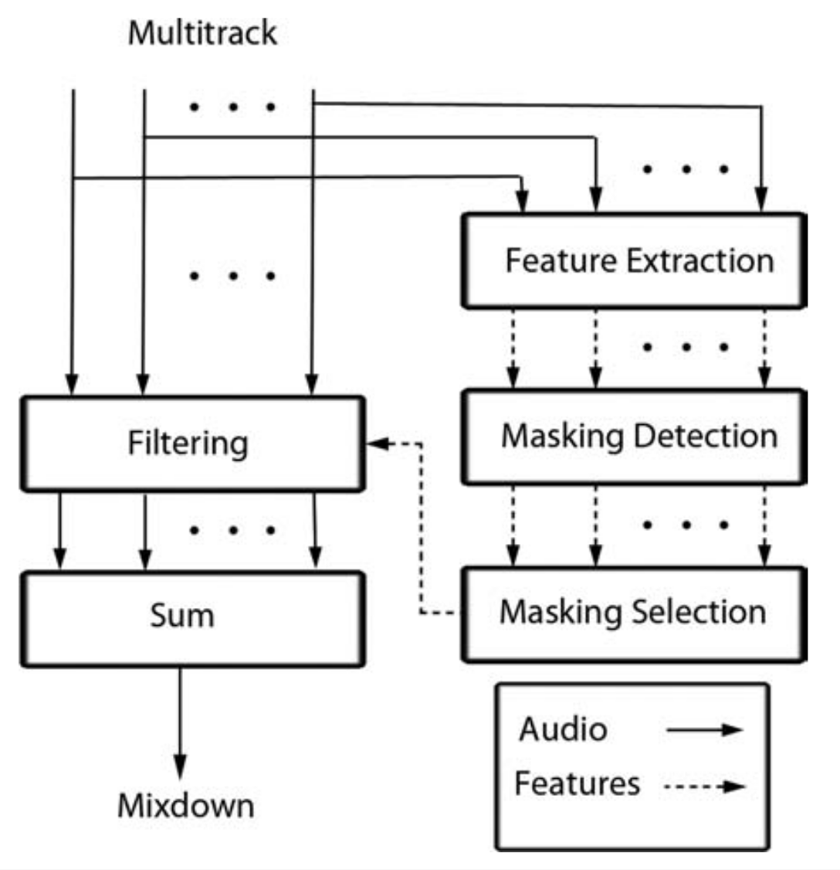
Baseline System: EQ
EQ
Frequency unmasking

Slide 5
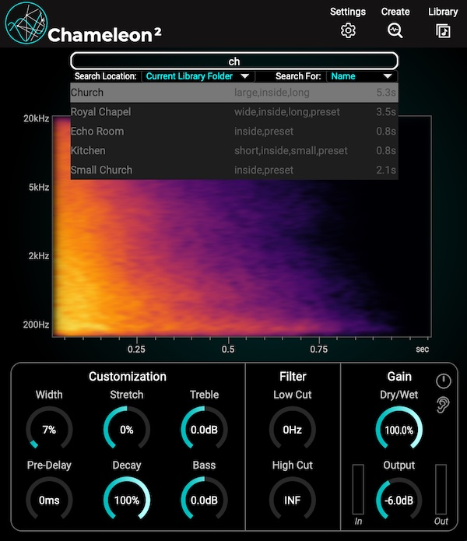
Rule-based System: reverb
Get the estimated impulse responses from the Chameleon plugin
Estimate the reverb parameters by the genetic algorithm
Use mean values extracted from the MUSDB18 train set
Reverb
Dry/wet ratio: 11.5%
Reverb time: Linear mapping from tempo
Room size: 14.54
Fade in time: 0.68 s

Slide 6
Data-driven System
Train a convolutional neural network to predict direct or intermediate mixing parameters based on the input audio
model input:
Mel-spectrogram of the vocal and the backing track

Slide 7
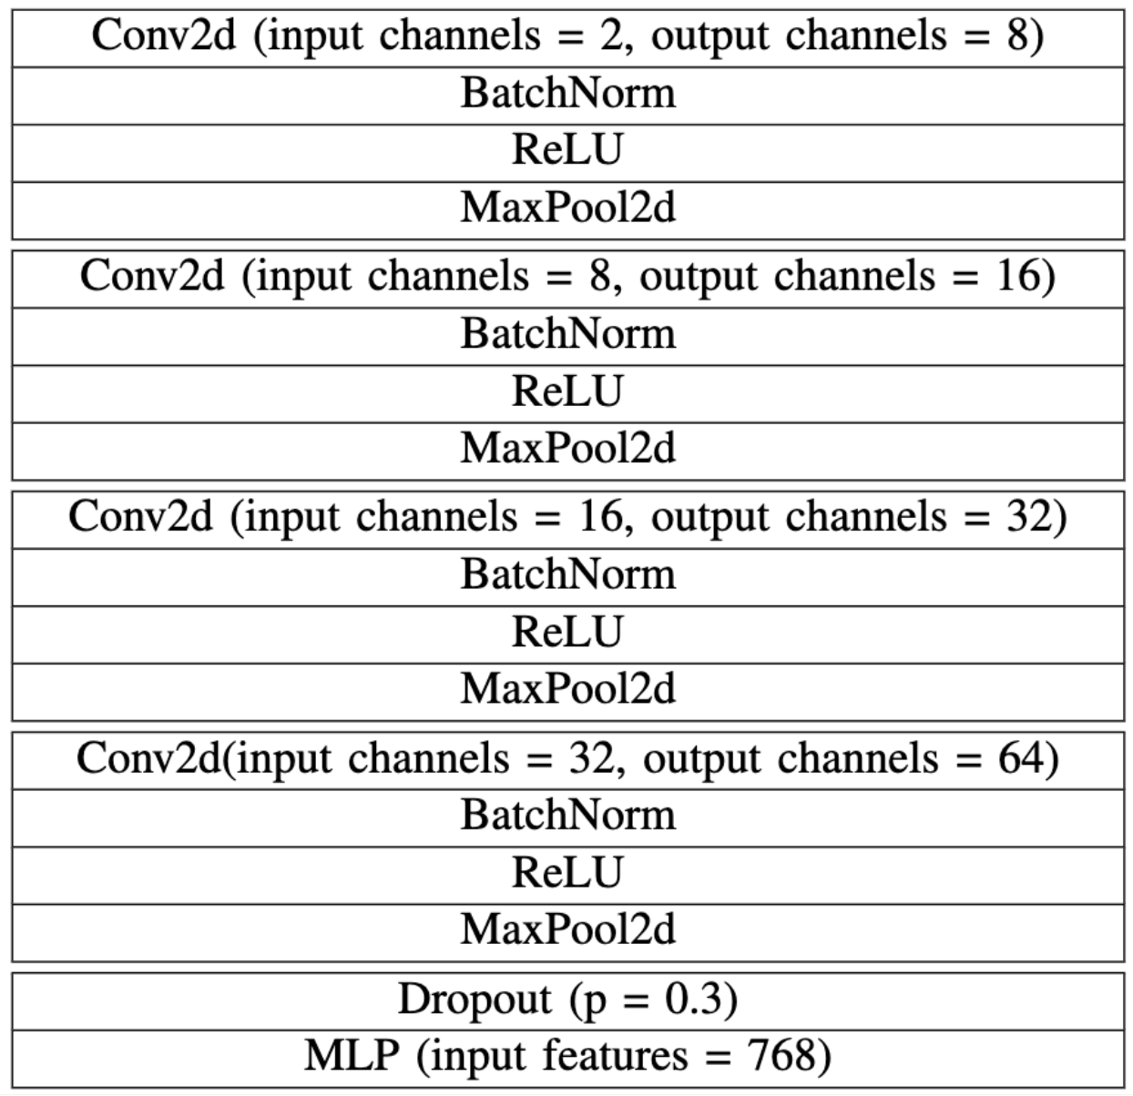
Data-driven System

Slide 8
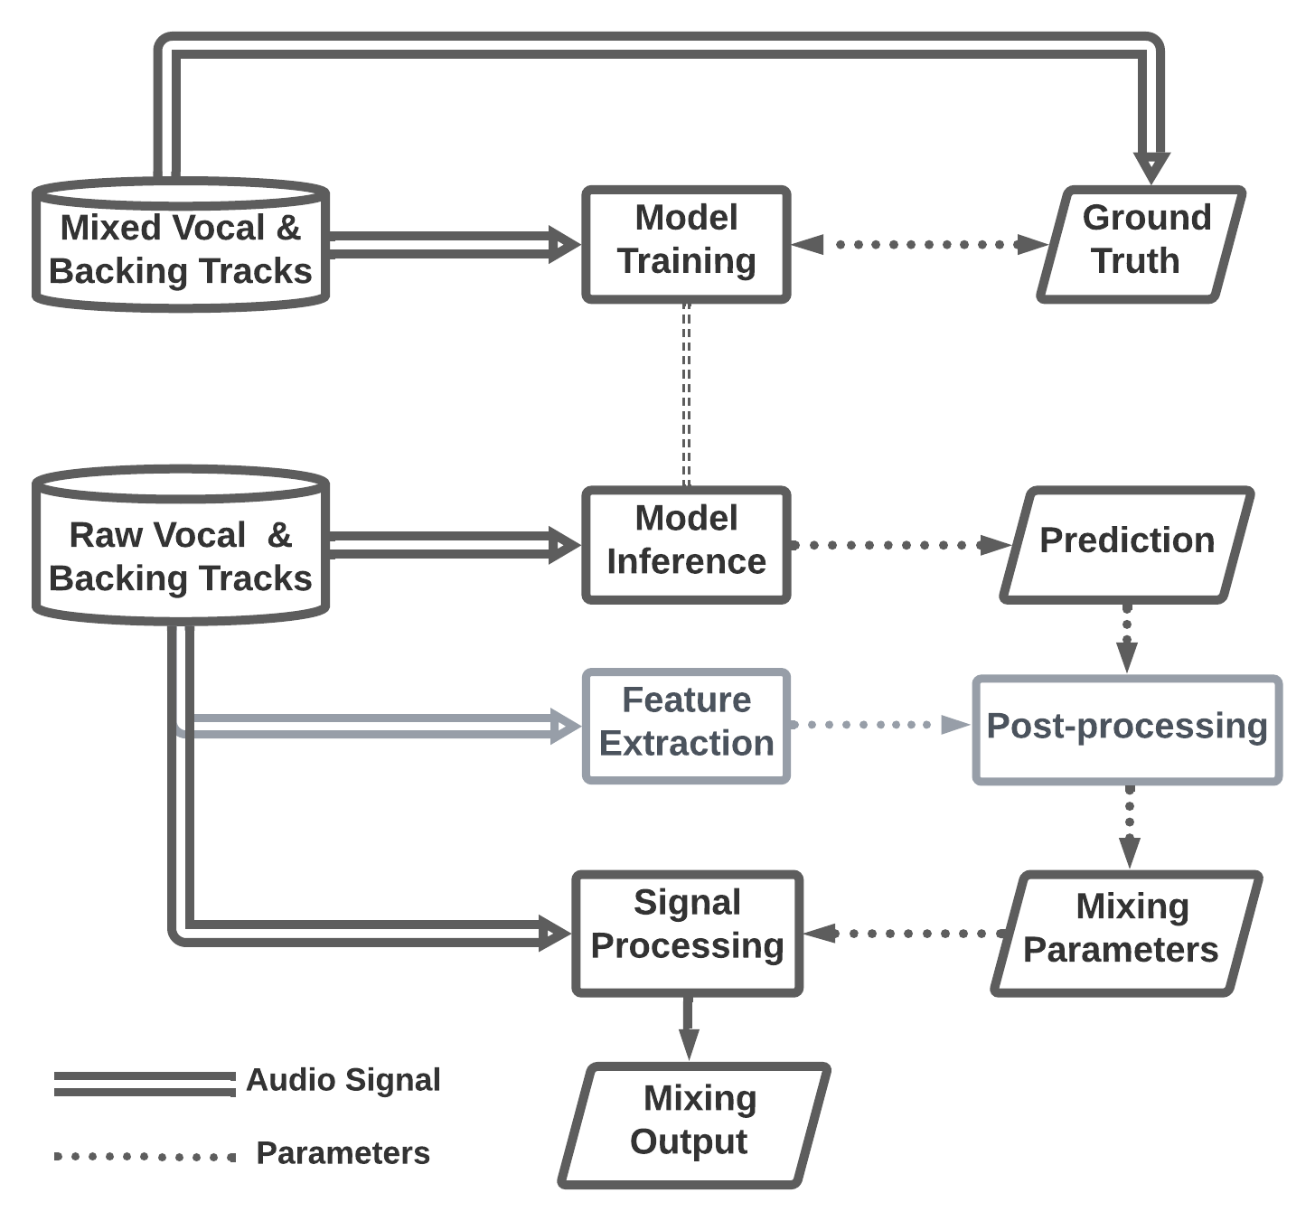

Model Training
Ground truth is the direct or intermediate mixing parameters
Optionally, convert intermediate model outputs into direct mixing parameters
Model Inference

Slide 9
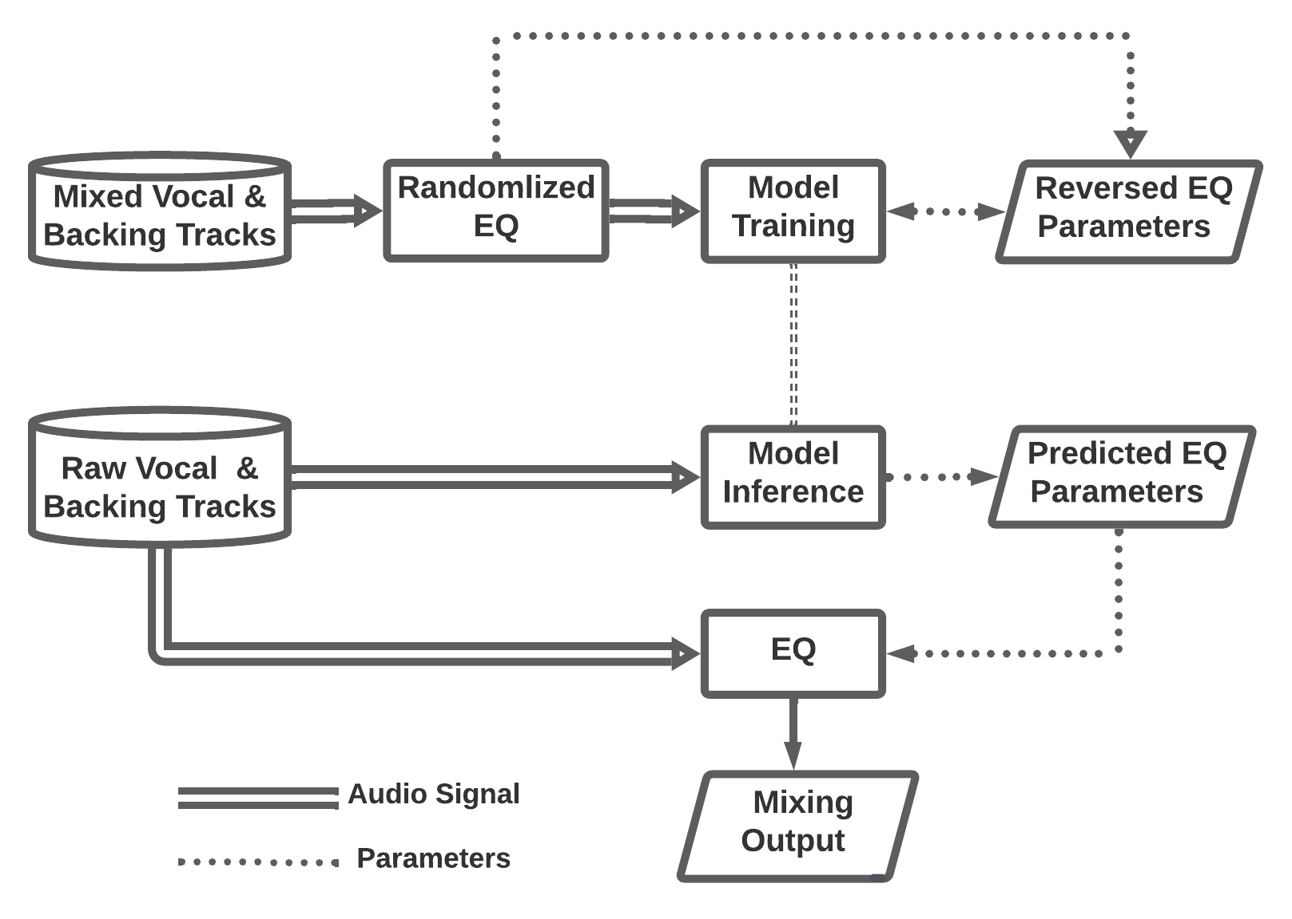
Data-driven System: EQ
Model Training
If the mixed vocal is boosted at a center frequency, we should learn to cut at that frequency.
Model Inference

Slide 10
Objective Evaluation
Validation on the MUSDB test set, 48 songs in total

Slide 11
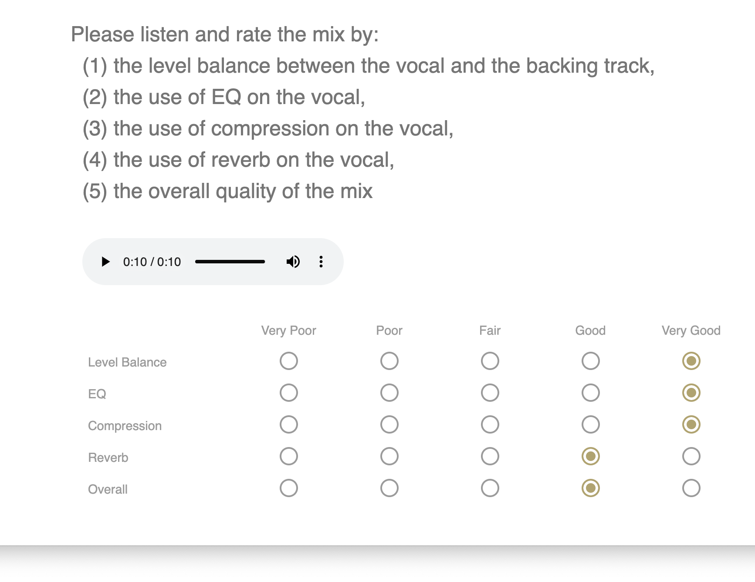
Listening Test

Slide 12

https://t.ly/0kur

